Slide 1
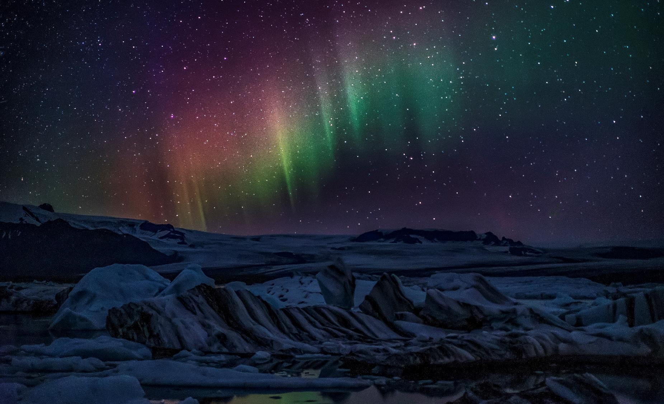
Machine Learning project
Under the Supervision of :
DR. Ali Hamza
Eng. Ahmed Nousir

Slide 2
Created By :
Name | ID
Ahmed Mostafa | 42010147
Aya Tarek | 42010581
Salma Elbadry | 42010548
Yassmen Mamdouh | 42010457
Mustafa Mahmoud Murad | 42010544
Abd El-Aziz Ayman | 42010193

Slide 3
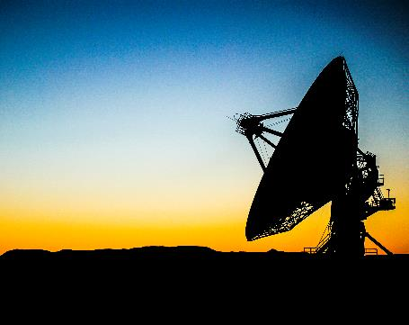
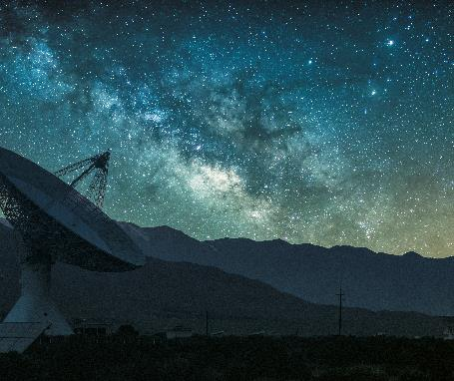
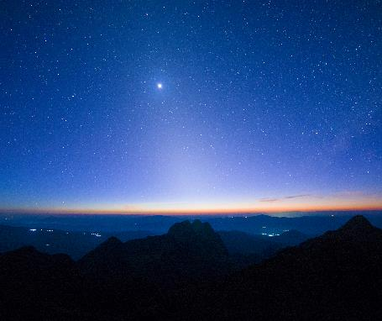
Introduction
Brief overview of the significance and applications of machine learning in today's data-driven world.
Highlighting the four internal projects:
Classification on spotify songs
CNN Classification on animals
Clustering on Online Retail
Regression on autos

Slide 4

Topic One
Regression on autos

Slide 5
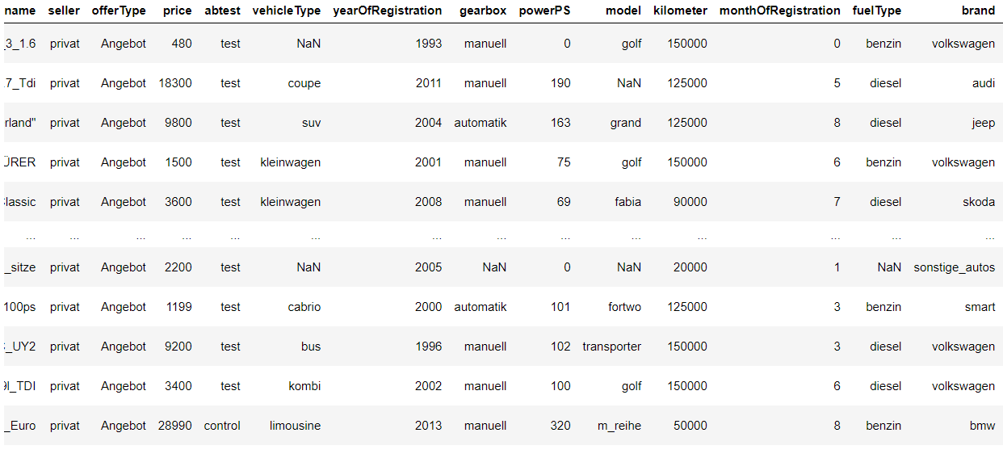
Regression on autos The dataset the regression objective for this dataset is to create a model that accurately predicts the price of used cars using the available features, facilitating a better understanding of the factors influencing the pricing of second-hand vehicles in the market

Slide 6
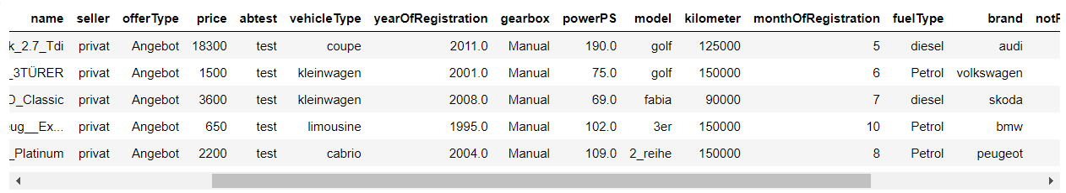
Regression on autos preprocessing

Slide 7
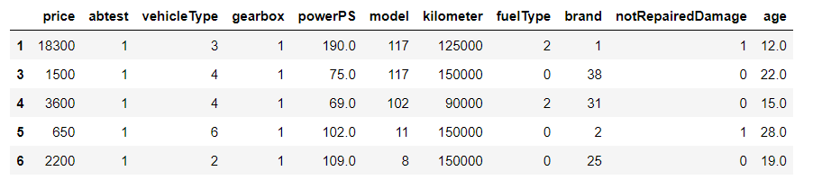
Regression on autos lable encoding

Slide 8
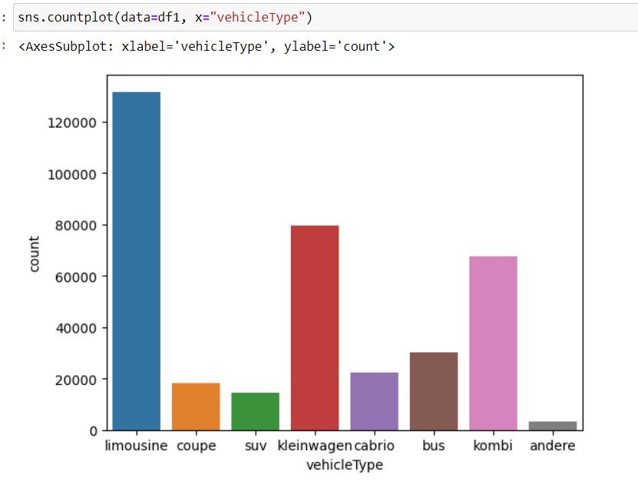
Regression on autos Data visualization

Slide 9
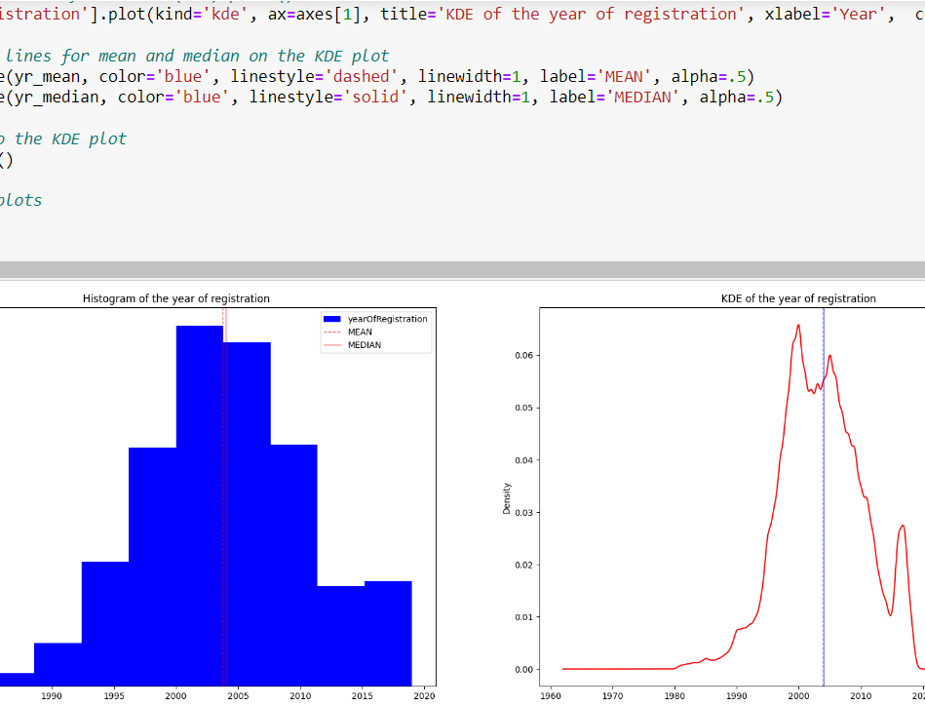
Regression on autos Data visualization

Slide 10
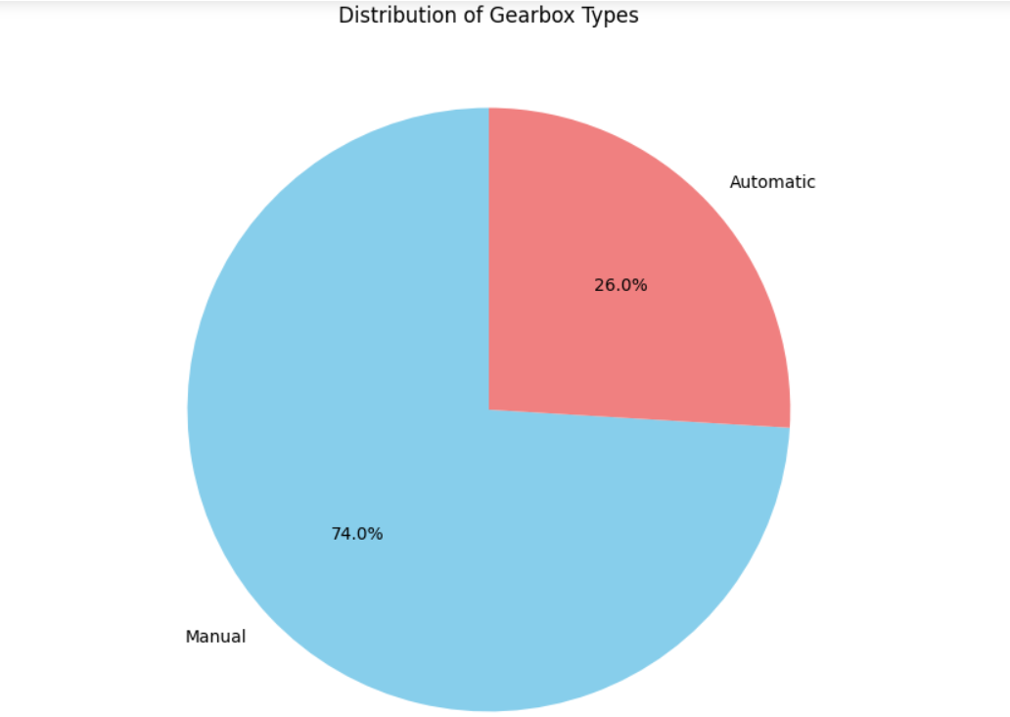
Regression on autos Data visualization

Slide 11
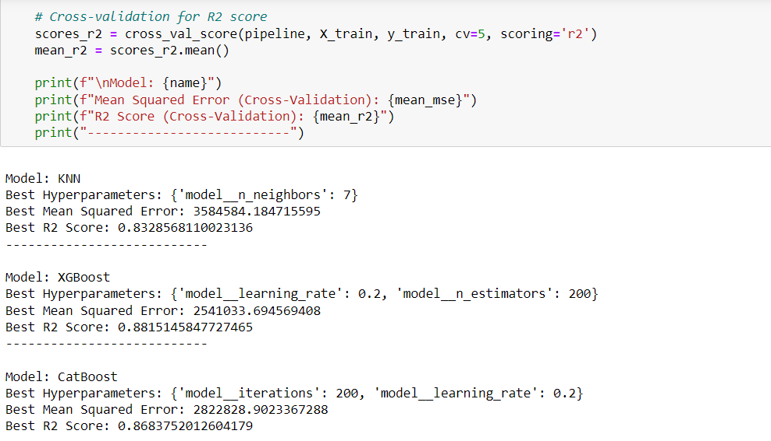
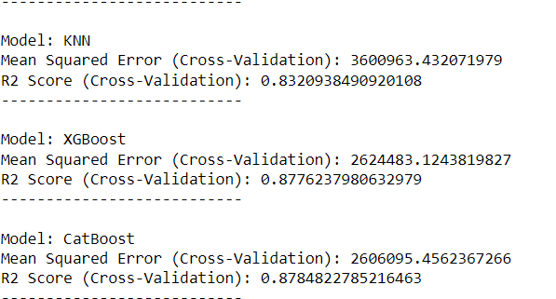
MODEL

Slide 12
Topic Two
Classification on spotify songs

Slide 13
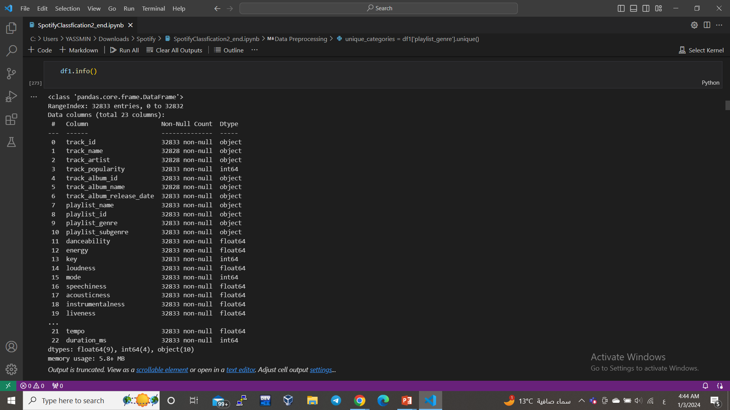
This data talks about the songs that are available on the Spotify platform. It starts by determining the playlist of the song. I tell you this about other data, including the type of song and the name. When I downloaded the song and the song has a movement first, and from these data I select the playlist) playlist_genre( .

Slide 14
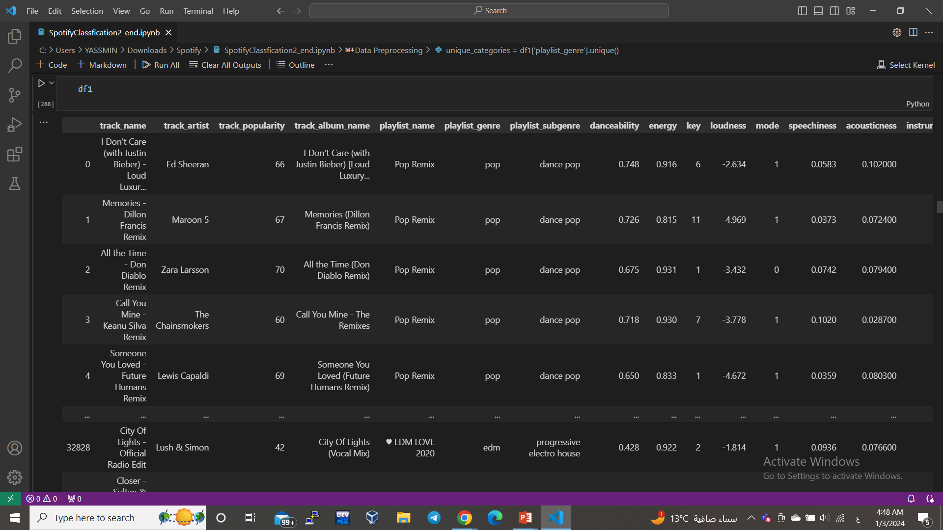
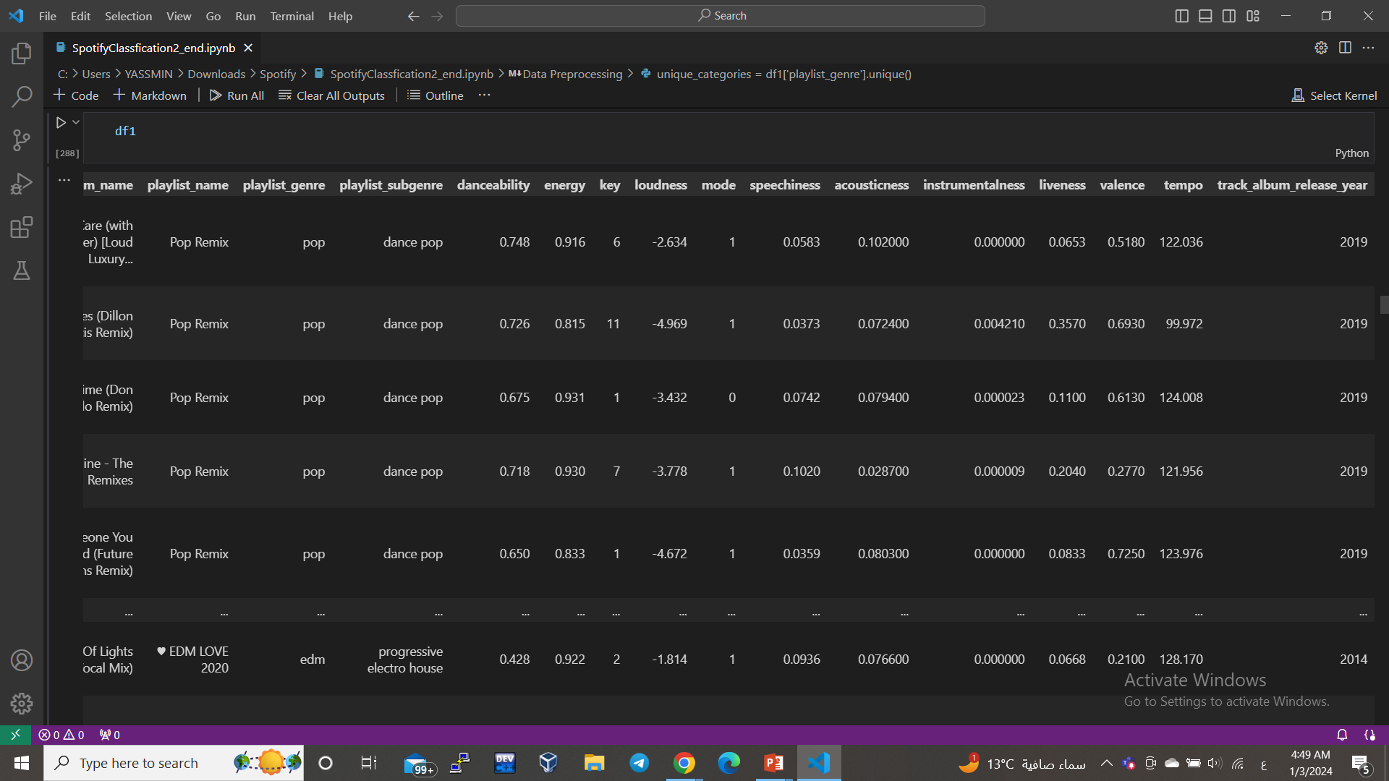

Slide 15
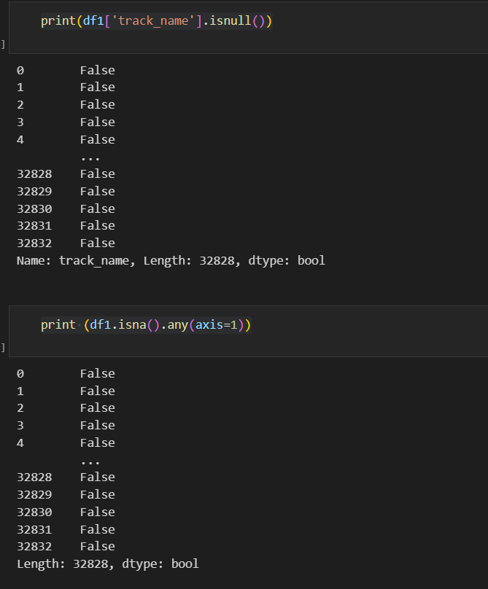
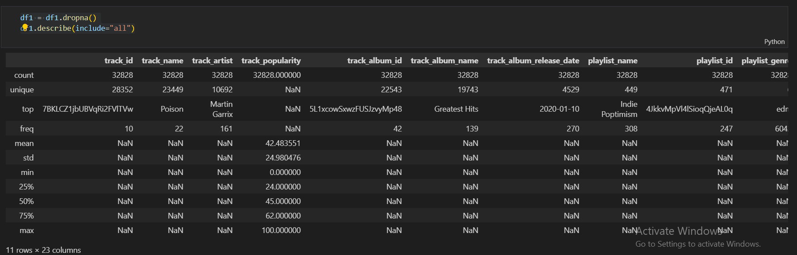

Slide 16
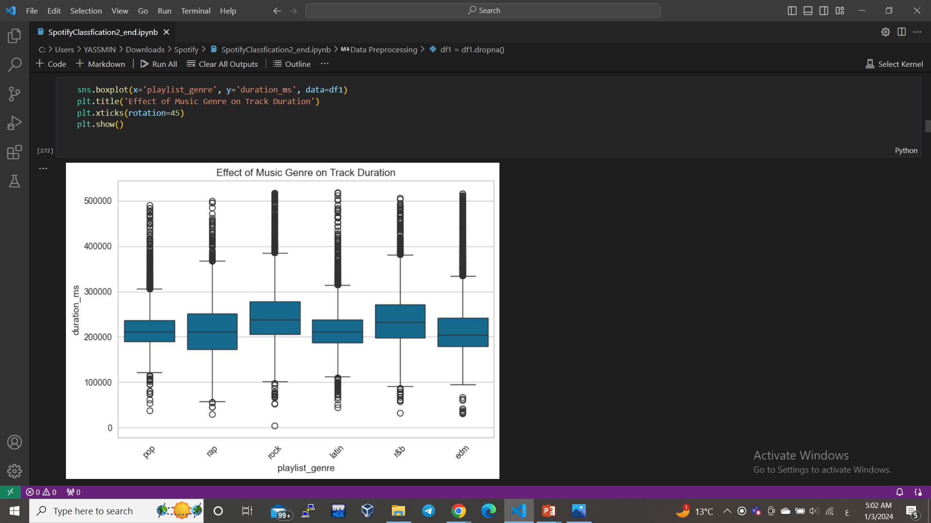
Outlier

Slide 17
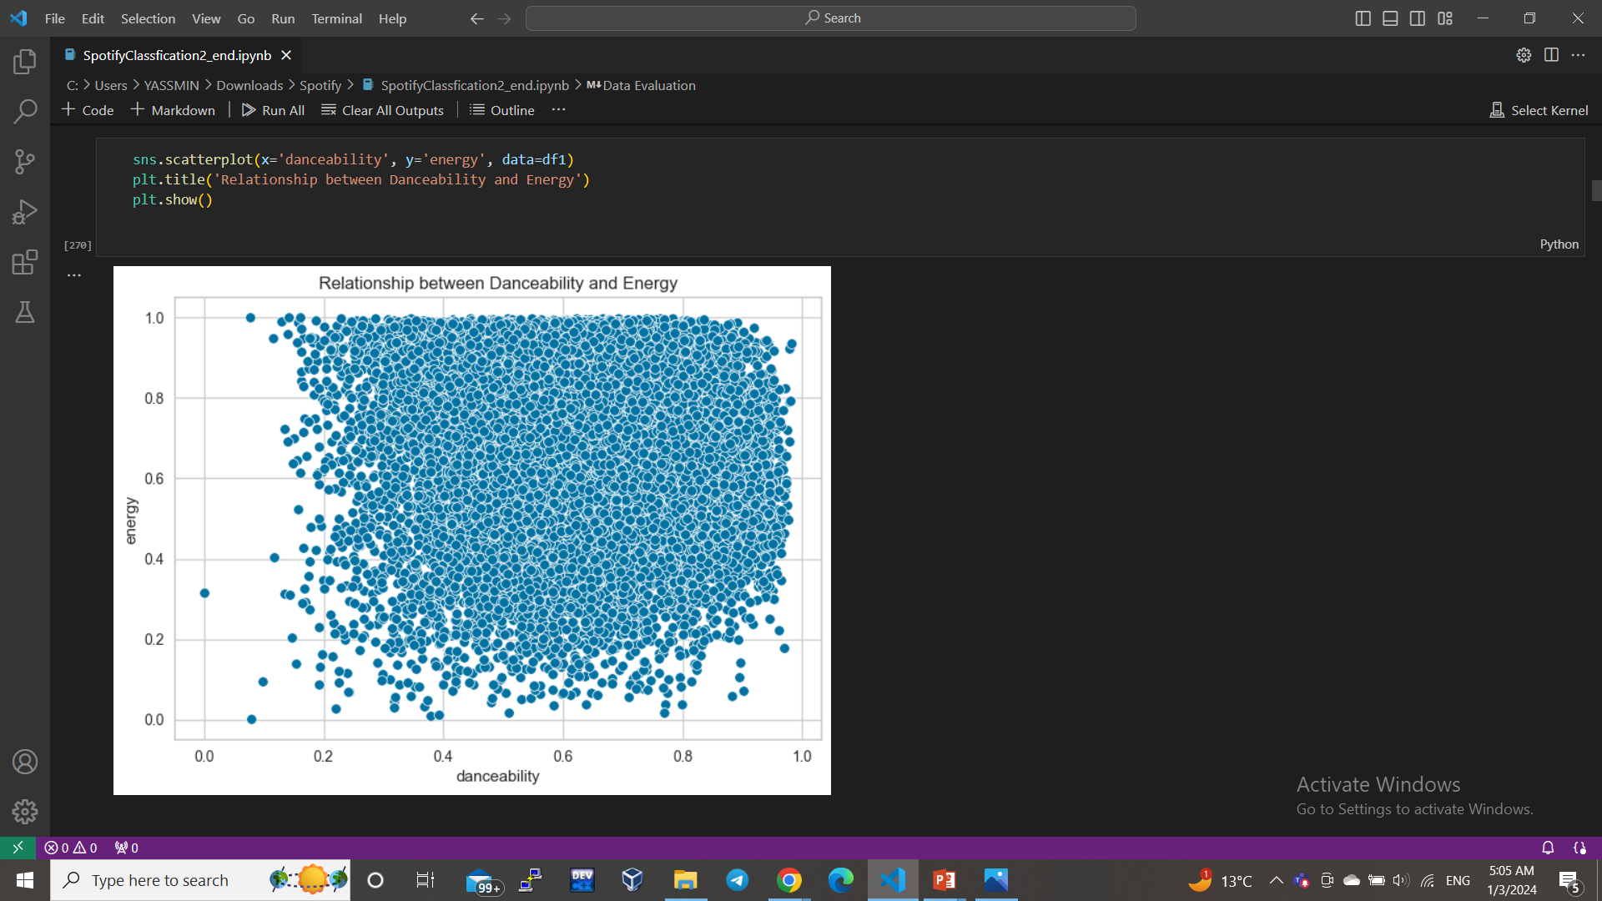
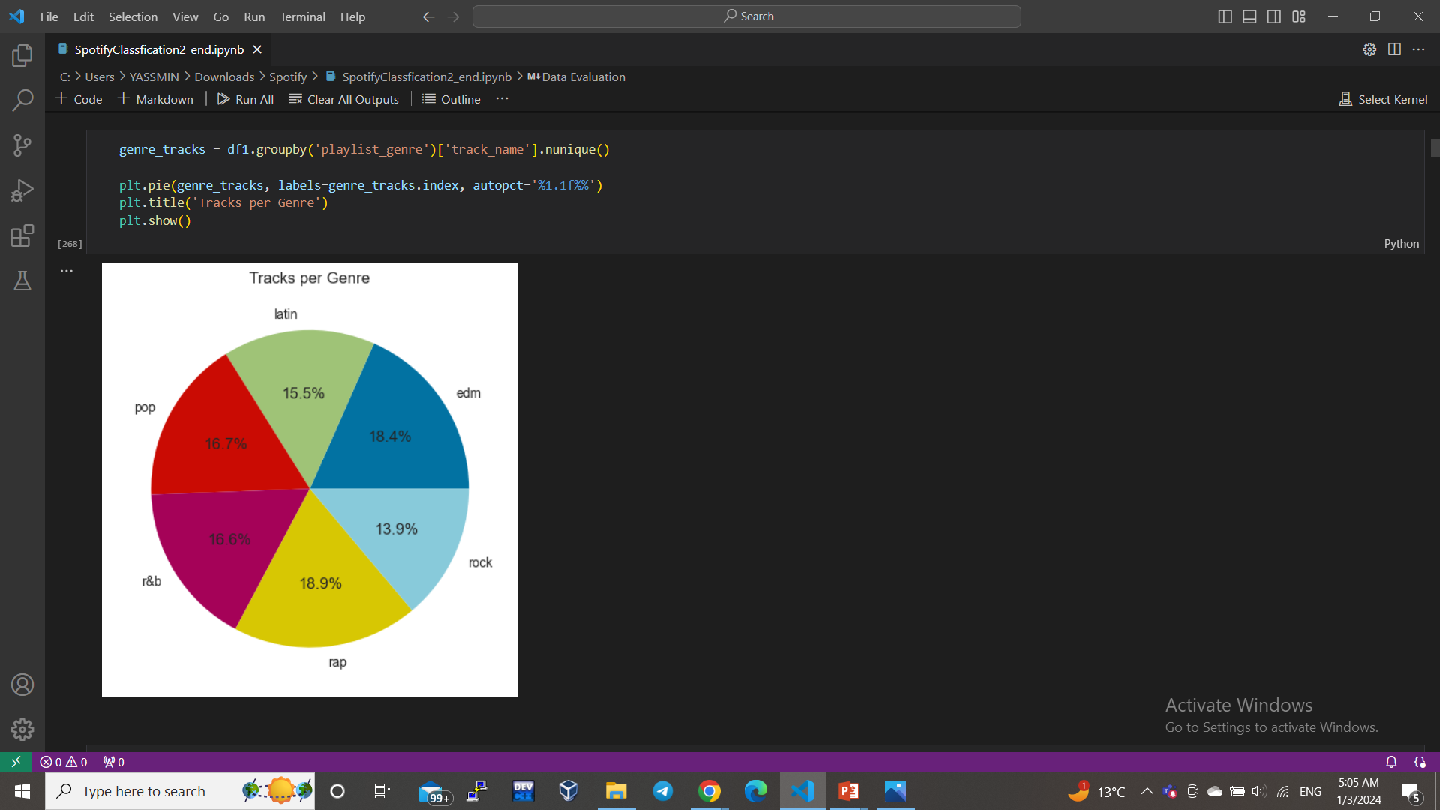
Data Visualizing

Slide 18
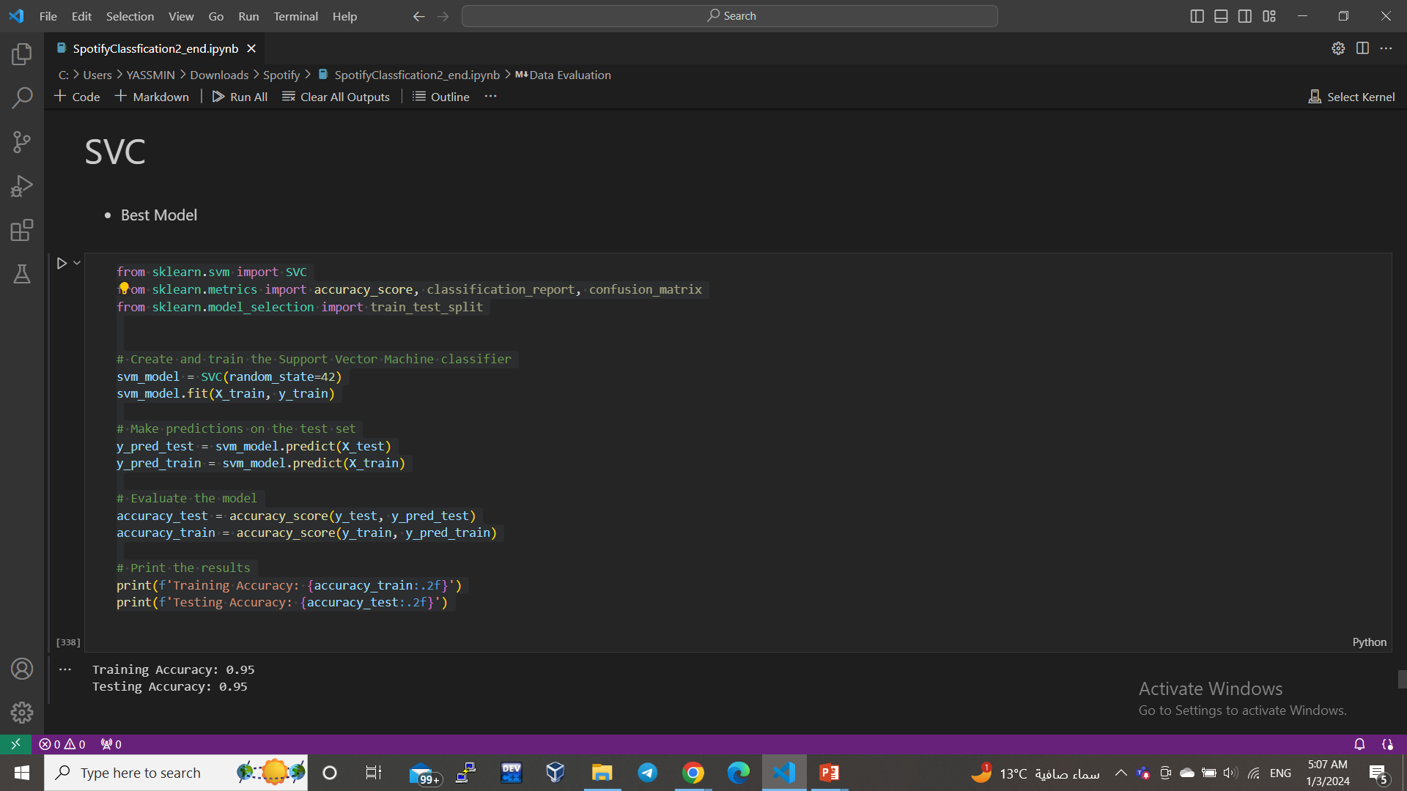
The best model

Slide 19
Topic Three
Clustering on online-retail

Slide 20
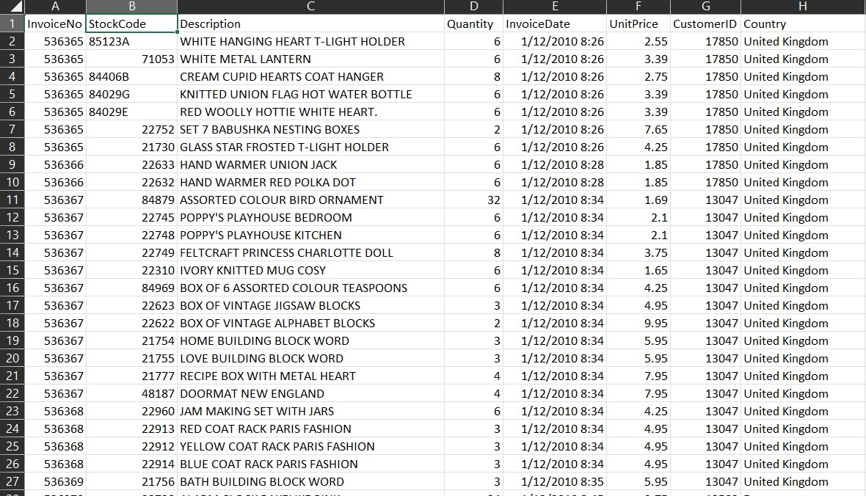
Clustering on online-retail
Dataset
We are talking about an invoice. Through analysis, we can find a pattern that will help us improve our data.

Slide 21
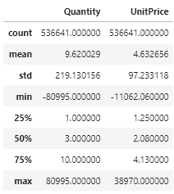
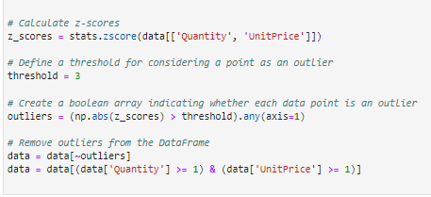
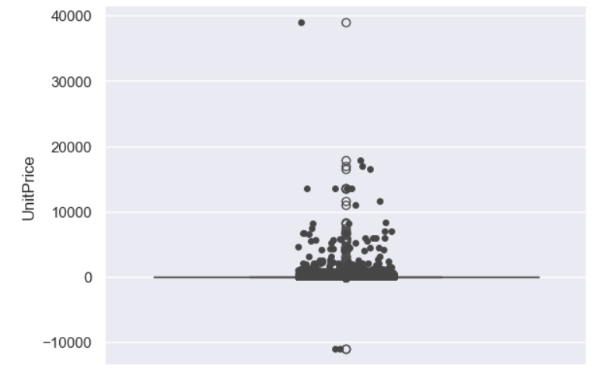
Clustering on online-retail
preprocessing
We did a preprocessing on the data we used, as is clear .
Starting with remove duplicate and end it with remove the outliers .

Slide 22
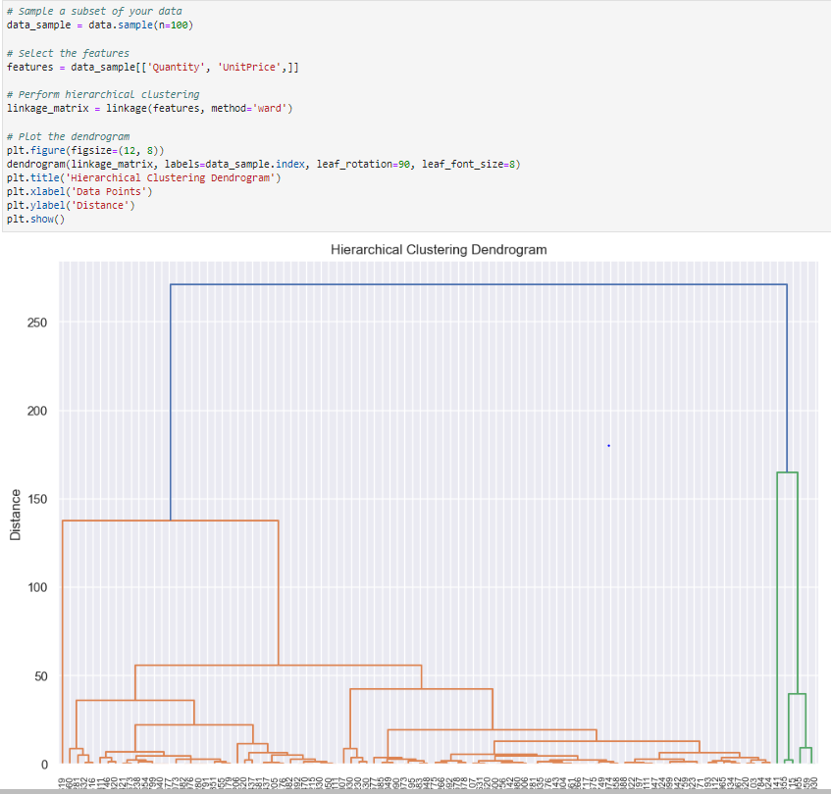
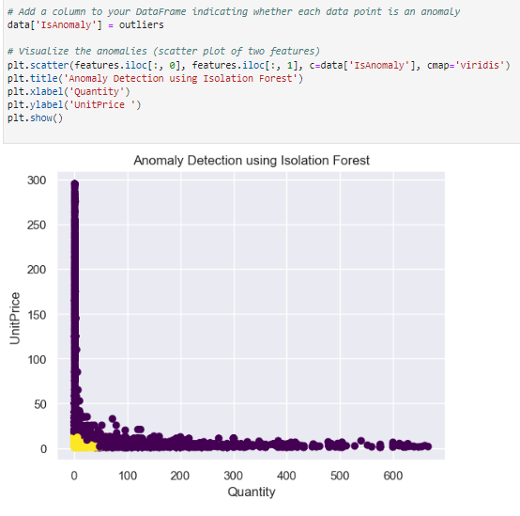
Clustering on online-retail
Cluster Model And Hierarchical

Slide 23
Topic Four
CNN ON ANIMALS

Slide 24
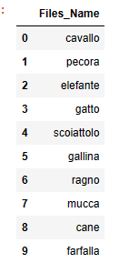
CNN Classification on detect animals
_This model explains CNN "Convolutional Neural Network“ ،this is a classification model foe detect the animal images.
_We use “MobileNetV3Small.” is a image classification. These networks are suitable for mobile and devices to r reduced the complexity
We have ten labels for ten kinds of animals

Slide 25
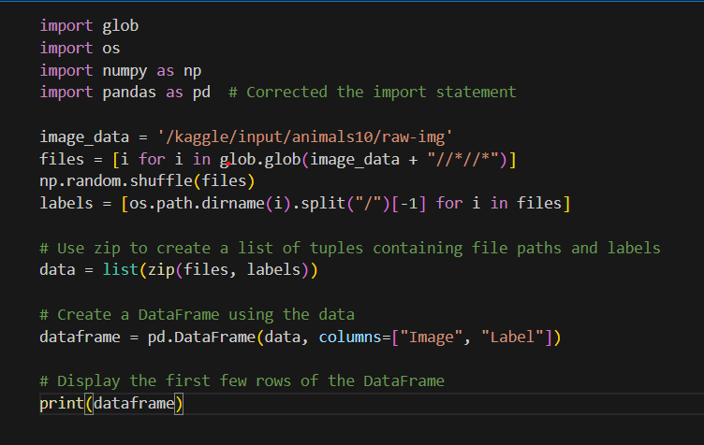
Handling
This code is designed to create a DataFrame from image files in the specified directory
(/kaggle/input/animals10/raw-img).

Slide 26
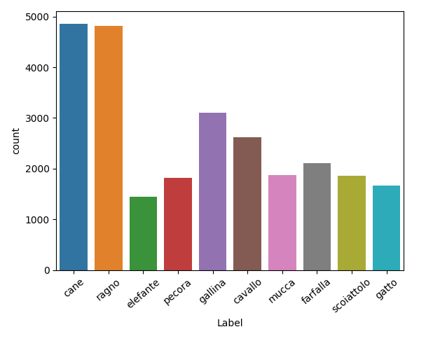
Visualization
this Visualization is defined the relationship between
numbers of images in every label.

Slide 27
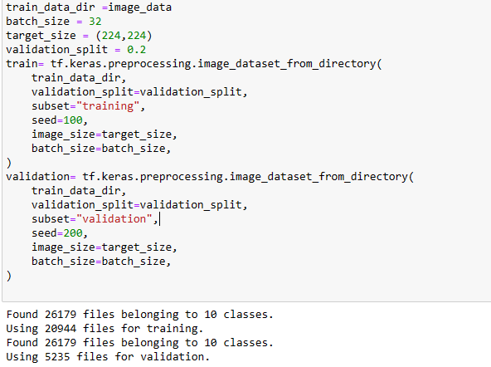
Split Train and Test Dataset

Slide 28
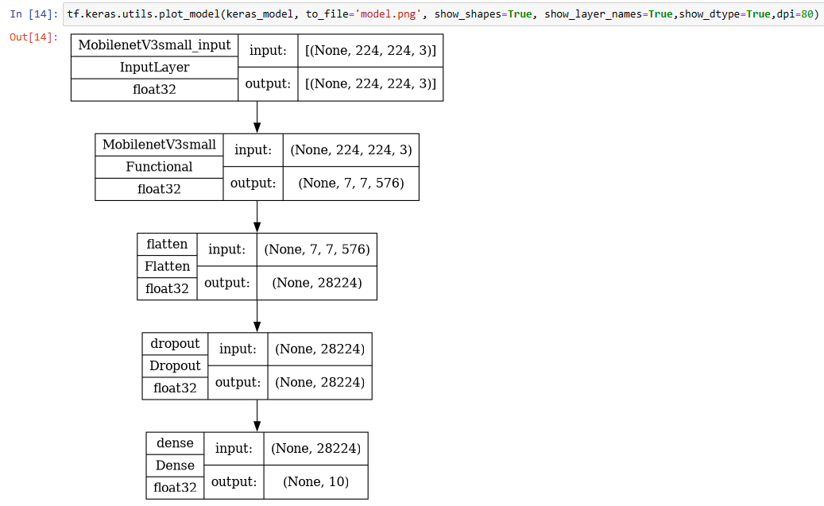
MobileNetV3Small Model

Slide 29
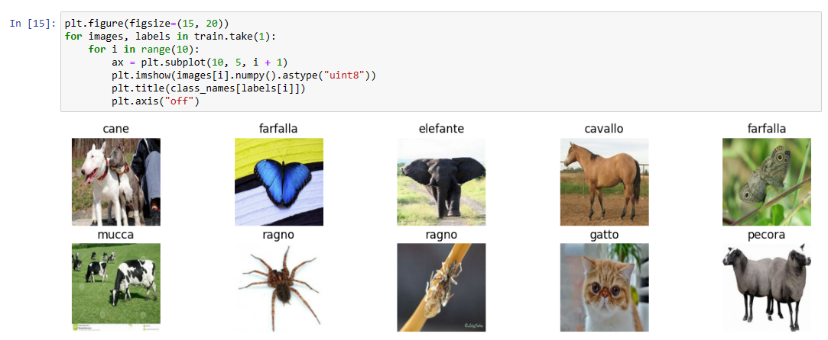

Slide 30
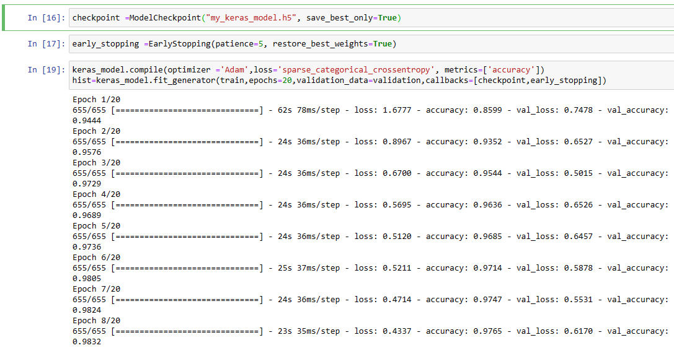

Slide 31
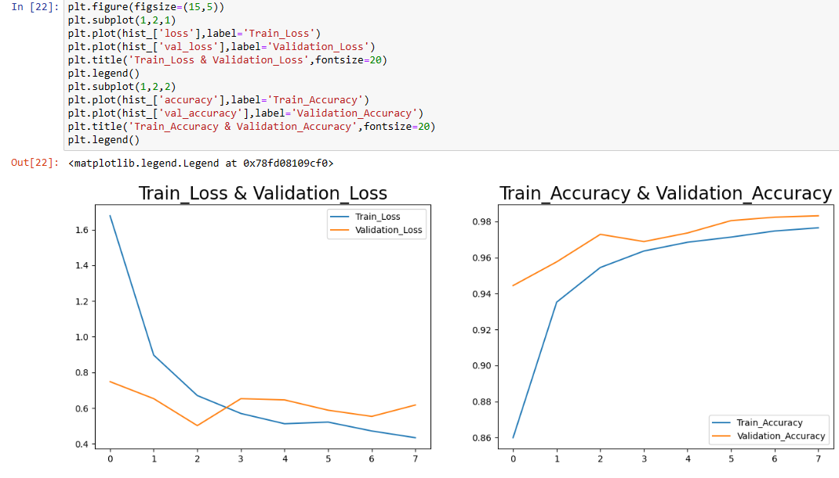
Histogram:

Slide 32
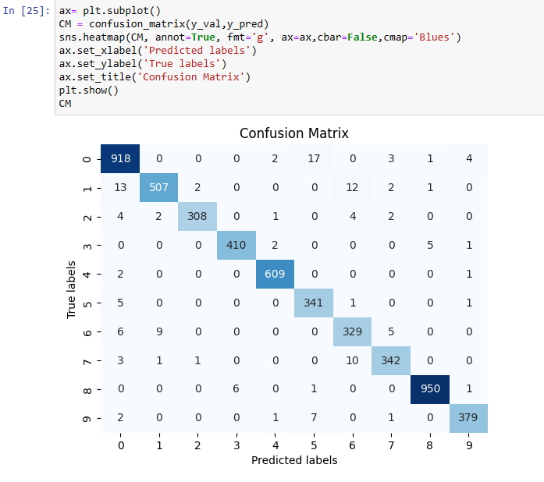
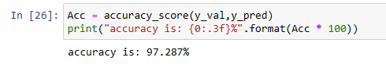
Histogram:

Slide 33
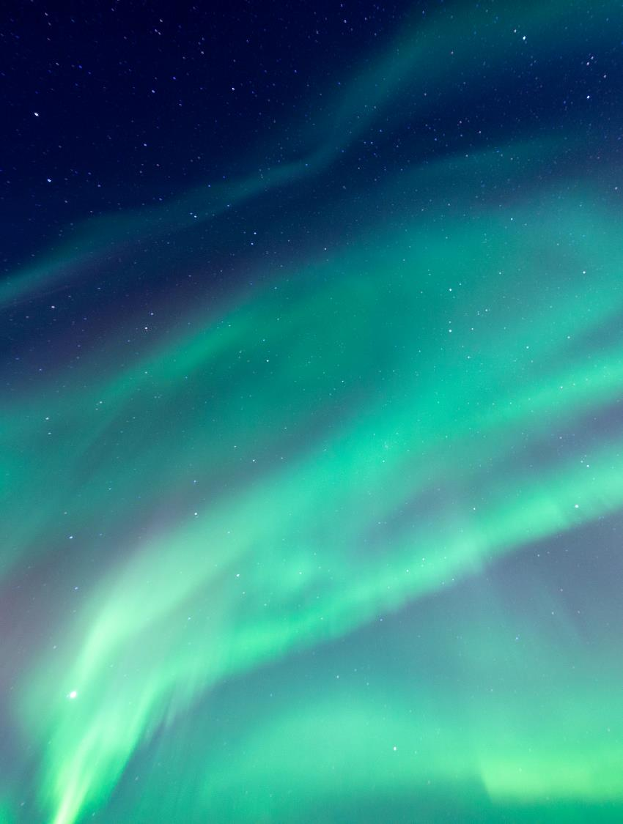
Thank You

